Slide 1


PRESENTATION ON COLLEGE PLACEMENT MANAGEMENT SYSTEM
Internal Guide
Mrs. ayesha norrain
Designation
Dept of AIML
KNSIT
Presented by
1. P.GANESH 2. PRABHAT SHAH 3. PRIYA 4. PUNITH
1KN21AI029 1KN21AI030 1KN21AI031 1KN21AI032

Slide 2
CONTENTS
Abstract
Introduction
About python & MYSQL
Application
ERD (Entity Relationship Diagram)
Schema Diagram
Libraries Used
Database Connection
Add Student Functionality
Search Student Functionality
Delete Student Functionality
Update Student Functionality
Display Student Functionality
Exit Student Functionality
User Interface Overview
Output
Conclusion

Slide 3
ABSTRACT
The College Placement System is a comprehensive solution designed to streamline the management of student records within educational institutions. Developed using Python and the tkinter library for graphical user interface (GUI) design, this system offers a robust set of features to administrators, faculty, and staff.
Central to its functionality is the seamless integration with a MySQL database, facilitated by the pymysql library. This ensures efficient data storage and retrieval, enabling quick access to student information and facilitating timely decision-making processes.
In addition to basic CRUD (Create, Read, Update, Delete) operations for managing student records, the system also incorporates advanced functionalities such as search and display capabilities. Through intuitive GUI elements like labels, entry fields, buttons, and tables, users can interact with the system effortlessly, enhancing user experience and efficiency.
Furthermore, the College Placement System prioritizes data integrity and security, implementing measures to safeguard sensitive information and prevent unauthorized access. By leveraging industry-standard practices in database management and GUI design, the system sets a high standard for usability and reliability in educational administration software.
Overall, the College Placement System represents a powerful tool for educational institutions seeking to streamline their administrative processes and enhance the management of student data. Its user-friendly interface, coupled with robust functionality and database integration, makes it a valuable asset for colleges and universities aiming to optimize their placement processes and improve overall efficiency.

Slide 4

INTRODUCTION
1. Streamlined Management: The College Placement Management System serves as a centralized platform for educational institutions to efficiently handle the complexities of student placement data, ensuring smoother processes for both administrators and students.
2. Technological Foundation: Developed with Python for its versatility and MySQL for its robust database management capabilities, the system offers a sturdy foundation for storing, organizing, and retrieving vast amounts of placement-related information securely.
3. Comprehensive Functionality: Offering a suite of functionalities including data entry, search, update, and deletion, the system empowers administrators with the tools needed to effectively manage student records throughout their placement journey.
4. Enhanced Operational Efficiency: By automating routine tasks and providing insightful data visualization tools, the system not only improves operational efficiency but also enables institutions to make data-driven decisions, ultimately fostering better placement outcomes for students.
Fig1: college placement system

Slide 5

ABOUT PYTHON
Python is a computer programming language often used to build websites and software, automate tasks, and conduct data analysis. Python is a general-purpose language, meaning it can be used to create a variety of different programs and isn’t specialized for any specific problems. This versatility, along with its beginner-friendliness, has made it one of the most-used programming languages today.
Python is commonly used for developing websites and software, task automation, data analysis, and data visualization. Since it’s relatively easy to learn, Python has been adopted by many non-programmers such as accountants and scientists, for a variety of everyday tasks, like organizing finances.
What can you do with python?
Data analysis and machine learning
Web development
Automation or scripting
Software testing and prototyping
Everyday tasks
Fig2: Python Programming

Slide 6
ABOUT MYSQL
1. Relational Database Management System (RDBMS): MySQL is a popular RDBMS known for its efficiency and h reliability in managing structured data.
2. Versatility in Applications: It is widely used for tasks such as storing and retrieving data for websites, web applications, and software solutions.
3. Automation and Scripting: MySQL facilitates automation of repetitive database tasks and scripting through support for stored procedures, triggers, and scheduled events.
4. Accessibility and Non-Programmer Use: Its user-friendly interface and accessibility make it suitable for non-programmers, including accountants and analysts, for organizing and analyzing data, particularly in financial contexts.

Slide 7
APPLICATION
1. Student Placement Record Management :
Efficiently manage student records, including academic achievements, skills, and placement status.
2. Employer Engagement and Job Posting :
Provide a platform for employers to post job opportunities and engage with students for recruitment purposes.
3. Interview Scheduling and Coordination :
Automate the scheduling and coordination of interviews between students and employers, streamlining the placement process.
4. Placement Analytics and Reporting :
Generate analytics and reports on placement trends, success rates, and employer feedback to optimize the placement process.

Slide 8
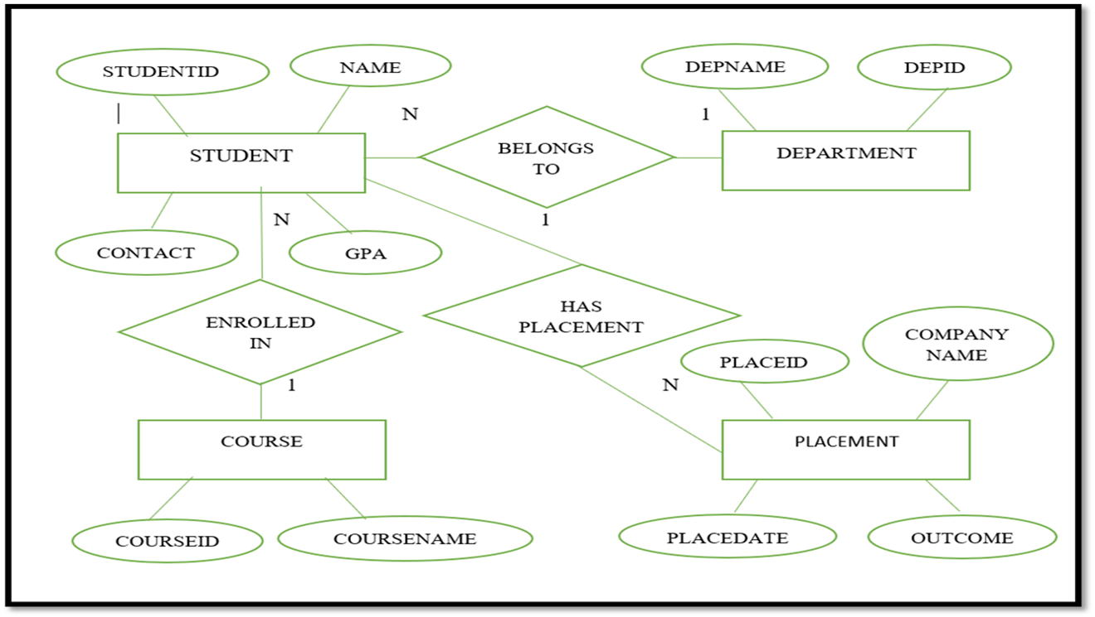
ERD (Entity Relationship Diagram)

Slide 9
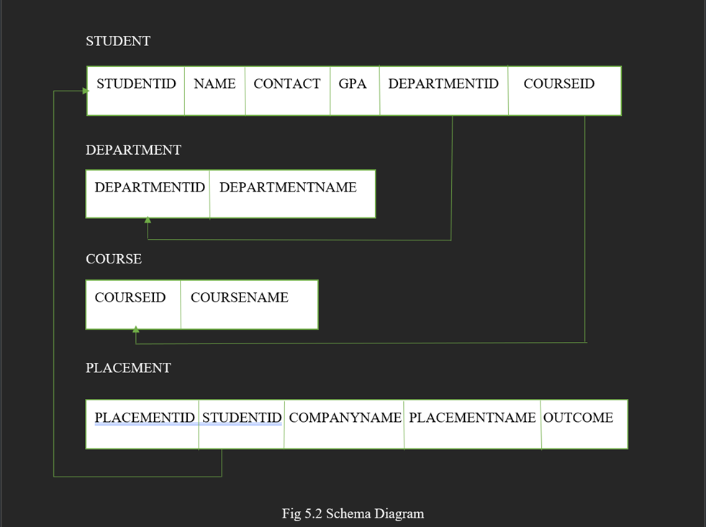
Schema Diagram

Slide 10
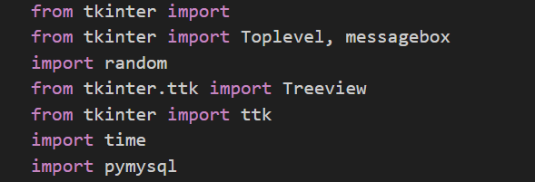
Libraries Used
from tkinter import
from tkinter import Toplevel, messagebox
import random
from tkinter.ttk import Treeview
from tkinter import ttk
import time
import pymysql
Fig3: Libraries Used

Slide 11
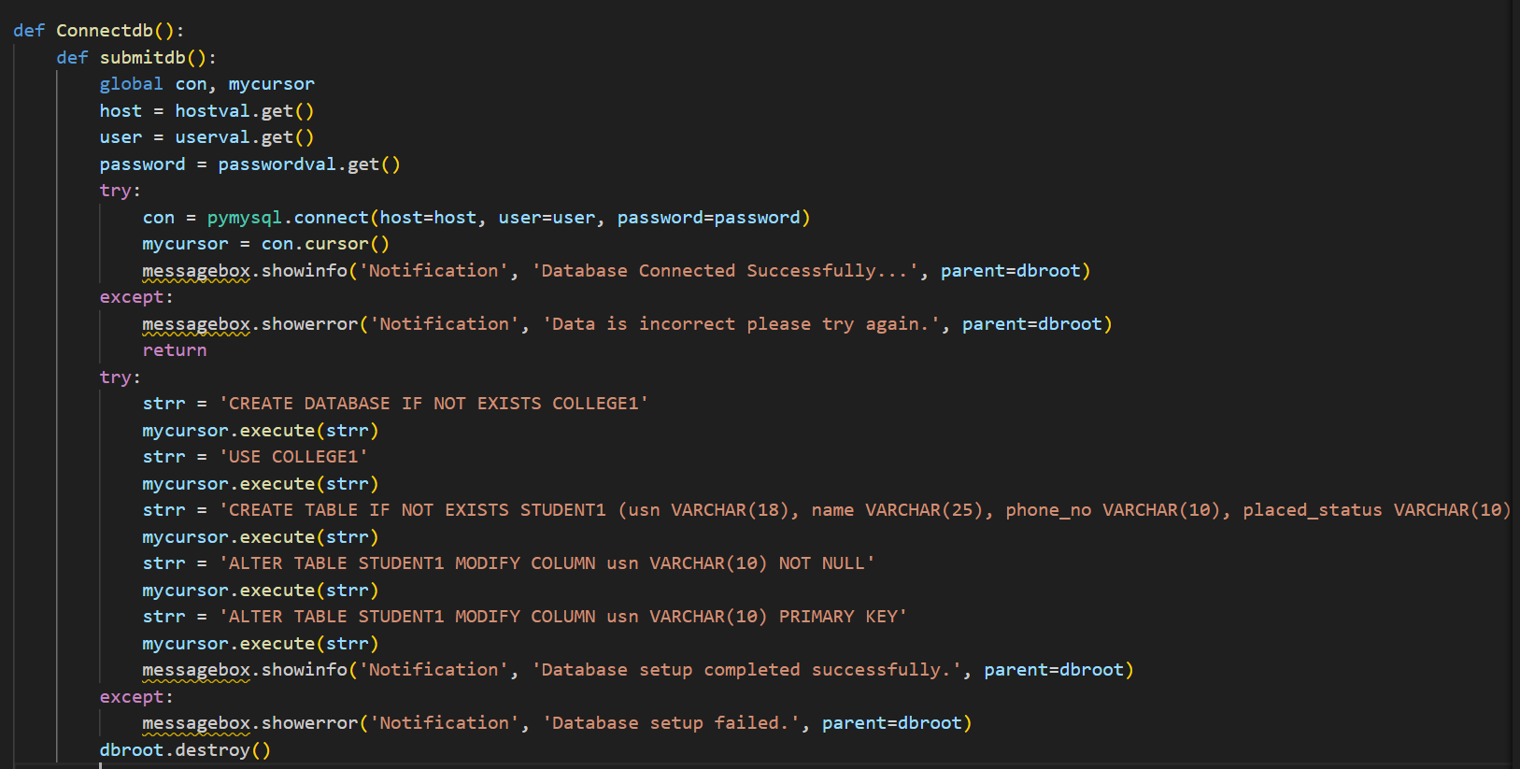
Database Connection

Slide 12
Database Connection
1. Import the Required Modules: - Import the `pymysql` module to enable interaction with the MySQL database.
- Optionally, import other necessary modules like `tkinter` for creating GUIs if needed.
2. Collect User Input: - Collect user input for the database host, username, and password using GUI elements like Entry widgets.
3. Attempt Database Connection: - Use the `pymysql.connect()` function to establish a connection to the MySQL database, passing the host, username, and password as parameters.
4. Handle Connection Errors: - Implement error handling using try-except blocks to manage potential exceptions during the connection process.
- Display informative messages to the user in case of success or failure in connecting to the database.
5. Perform Database Operations: - After successfully connecting to the database, you can perform various database operations such as querying, inserting, updating, or deleting data as per your application requirements.

Slide 13
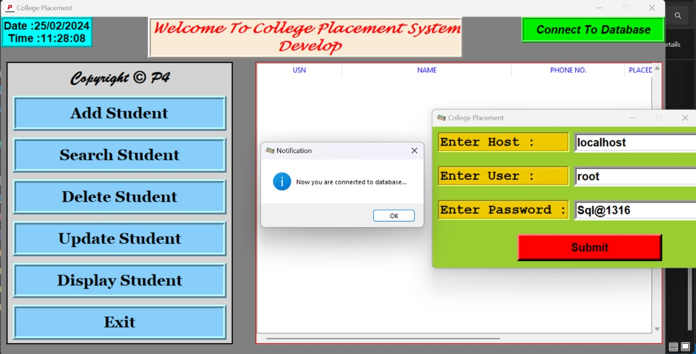
Database Connection

Slide 14
Add Student Functionality
1. Input Collection: Gather student details like USN, name, mobile number, placement status, and company name from user input fields.
2. Data Validation: Validate user input to ensure correctness and completeness, checking for missing fields or invalid formats.
3. Database Interaction: Insert the student details into the MySQL database table, handling any potential errors during the process.
4. Confirmation Message: Display a confirmation message upon successful addition of the student record, allowing users to clear input fields for further additions.
5. Error Handling: Implement error handling to manage exceptions gracefully, providing informative messages to users in case of errors during the addition process.

Slide 15
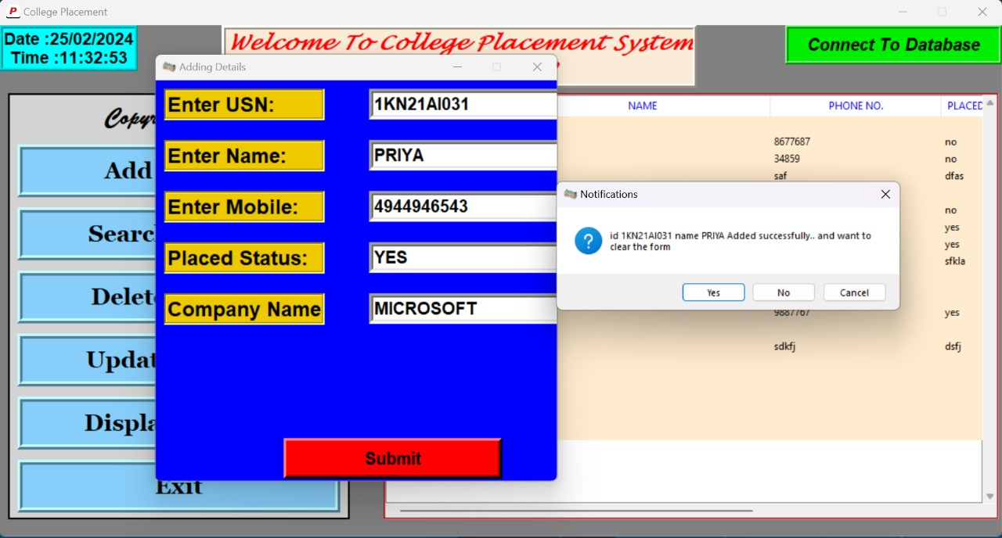
Add Student Functionality

Slide 16
Search Student Functionality
1. Input Collection: Gather search criteria such as USN, name, mobile number, placement status, or company name from user input fields.
2. Query Execution: Execute SQL queries based on the provided search criteria to retrieve relevant student records from the database.
3. Display Results: Display the retrieved student records in a table or list format within the GUI, allowing users to view relevant information.
4. Error Handling: Implement error handling to manage cases where no matching records are found or if there are any issues with executing the search query. Provide appropriate feedback to the user in such scenarios.

Slide 17
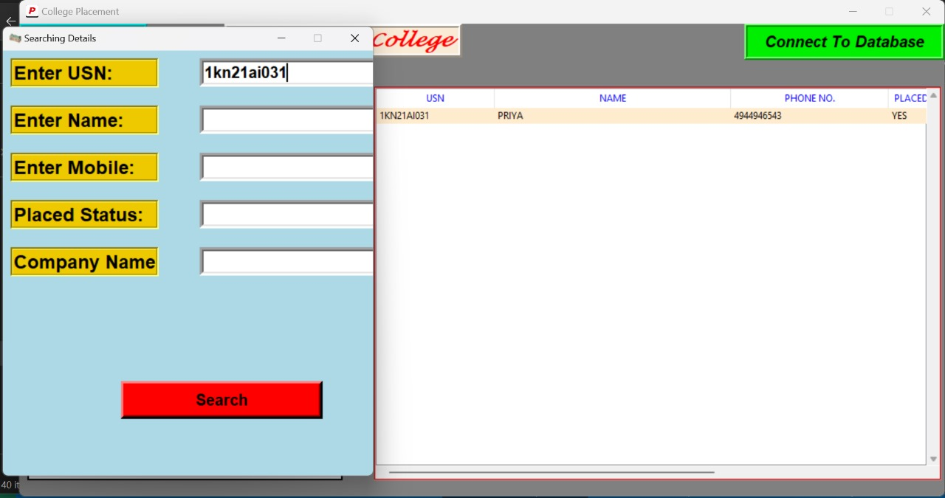
Search Student Functionality

Slide 18
Delete Student Functionality
1. Selection: Allow users to select the student record they want to delete, typically by clicking on the record in a table or list displayed in the GUI.
2. Confirmation: Prompt the user to confirm the deletion action to prevent accidental deletions of student records.
3. Database Interaction: Connect to the MySQL database and delete the selected student record from the appropriate table, handling any potential errors during the deletion process.
4. Update GUI: Update the graphical user interface to reflect the removal of the deleted student record from the displayed table or list, ensuring that the interface remains up-to-date and responsive.

Slide 19
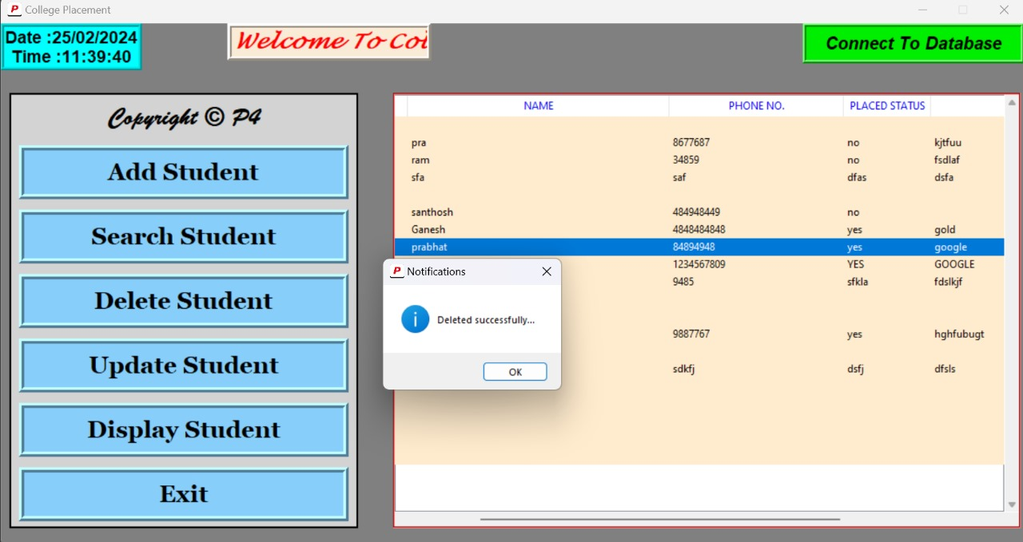
Delete Student Functionality

Slide 20
Update Student Functionality
1. User Input Retrieval:
- The update functionality retrieves user input for the student's USN (University Serial Number), name, phone number, placed status, and company name from GUI elements like Entry widgets.
2. Database Update Query:
- Upon user submission, the code constructs and executes an SQL query to update the corresponding student record in the database with the new information provided by the user.
3. Feedback to User:
- Informative messagebox notifications are displayed to the user to indicate the success or failure of the update operation, providing feedback on the status of the update process.
4. Refreshing Display:
- After successfully updating the database record, the code refreshes the display to reflect the updated information in the GUI table, ensuring consistency between the database and the application interface.

Slide 21
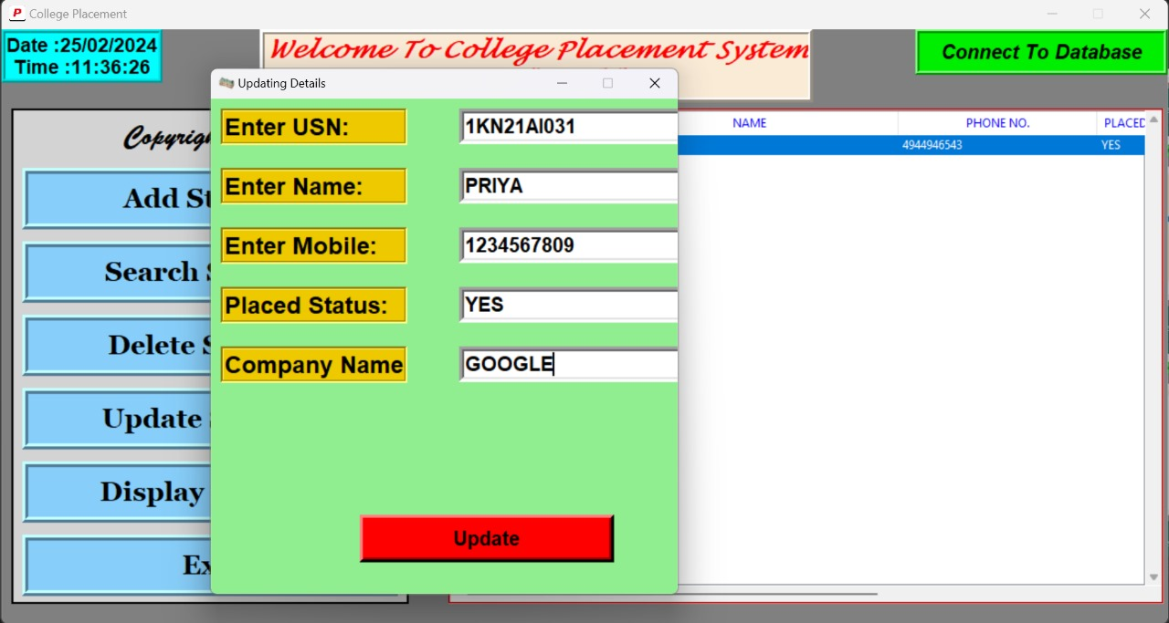
Update Student Functionality

Slide 22
Display Student Functionality
1. Database Query: Retrieve student records from the MySQL database table containing student information.
2. Data Presentation: Format the retrieved data appropriately for display, ensuring clarity and readability.
3. Update GUI: Populate the graphical user interface (GUI) with the fetched student records, such as displaying them in a table or list.
4. Error Handling: Implement error handling to manage situations where data retrieval fails or encounters errors, providing informative messages to users.

Slide 23
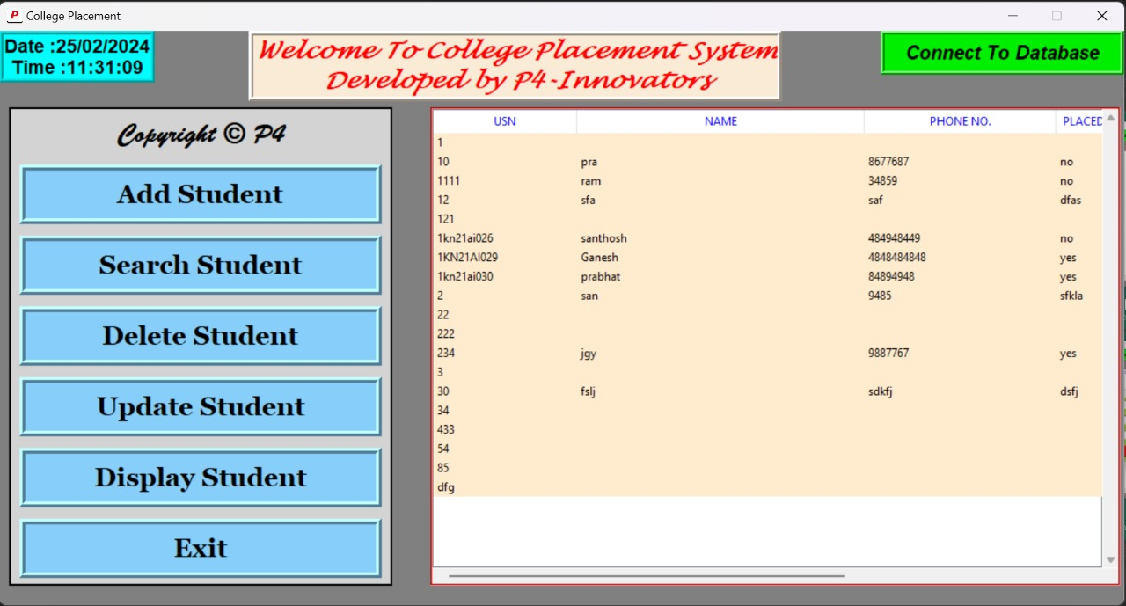
Display Student Functionality

Slide 24
Exit Student Functionality
1. Confirmation Prompt: Display a confirmation prompt to the user asking if they want to exit the application.
2. User Response Handling: Capture the user's response from the prompt and proceed accordingly based on their choice.
3. Graceful Exit: If the user chooses to exit, close the application window or terminate the program in a graceful manner.
4. Data Saving (Optional): Optionally, save any unsaved data or perform necessary cleanup tasks before exiting the application.

Slide 25
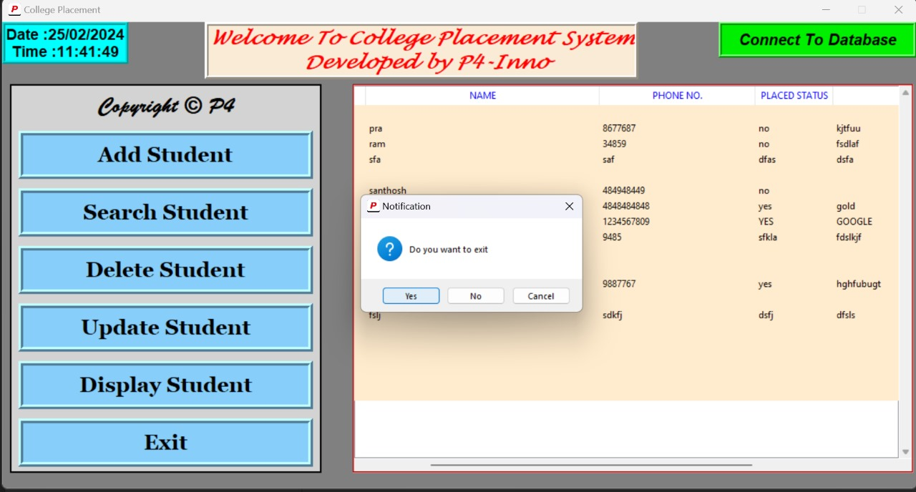
Exit Student Functionality

Slide 26
CONCLUSION
The College Placement Management System, developed using Python and MySQL, offers a comprehensive solution for efficiently managing student data in the context of college placements. Through a user-friendly interface built with tkinter GUI elements, users can seamlessly navigate and utilize various functionalities such as adding, searching, updating, and deleting student records. The integration with MySQL ensures secure and efficient storage and retrieval of data, enabling seamless interaction between the application and the database backend.
This project underscores the practical application of Python and MySQL in real-world software development, showcasing their versatility and effectiveness in addressing complex data management tasks. With robust error handling mechanisms in place, the system ensures smooth operation and provides informative feedback to users in case of errors or unexpected events. The modular design of the system allows for scalability and customization, enabling easy adaptation to specific requirements or future enhancements.
Overall, the College Placement Management System exemplifies the successful integration of technology to streamline and optimize the management of student data in college placement processes. Its intuitive interface, coupled with robust functionality, empowers college administrators and placement coordinators to efficiently organize and track student placement information, ultimately contributing to smoother and more effective placement processes.

Slide 27
THANK YOU

